Slide 1
Intro to Truffle
Suite
Notes:
Hey this is speaker notes

Slide 2
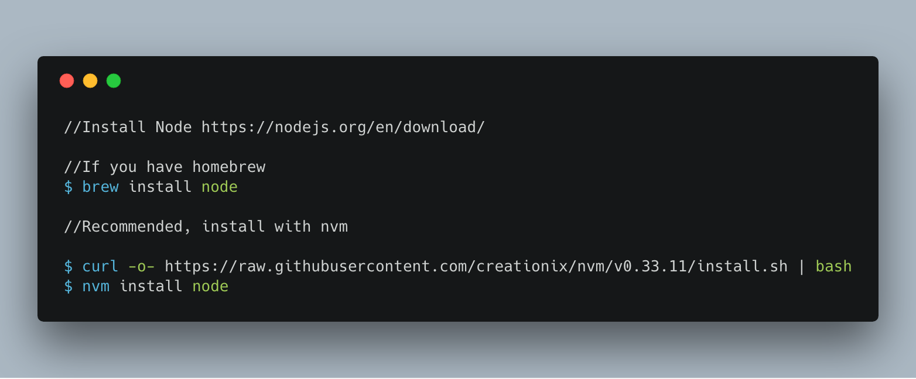
Before we go intro truffle
https://goo.gl/5qWr1z

Slide 3
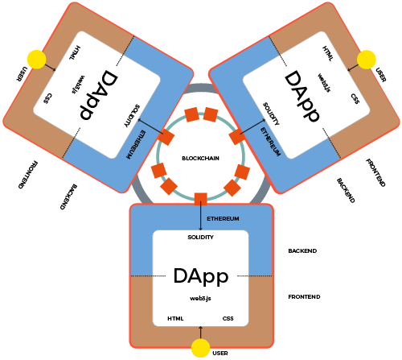
Deploying a Smart Contract
Backend - Solidity, EVM
FrontEnd - Web3.js, Node, HTML, CSS
Learn More : https://solidity.readthedocs.io/en/v0.4.24/introduction-to-smart-contracts.html

Slide 4
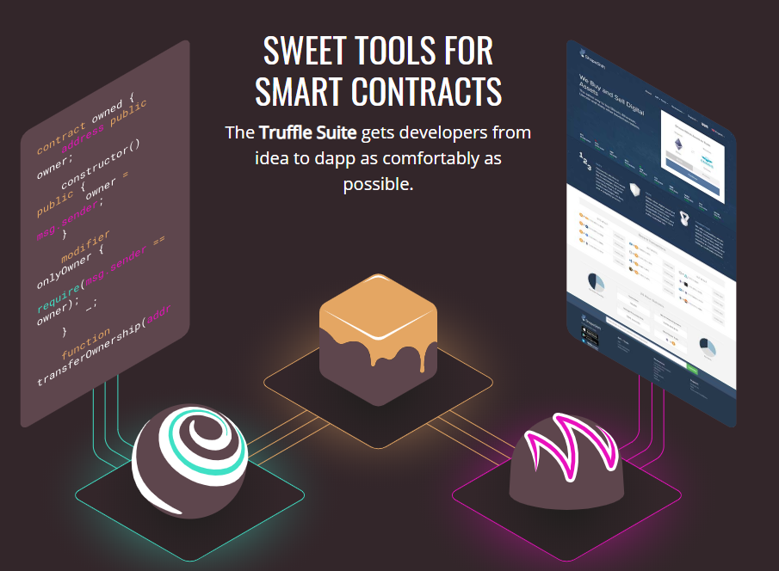
Truffle Suite
What is it?
A suite of 3 tools
Truffle
Ganache
Drizzle
Make your life much easier.
Written in JS, provided as NPM modules.

Slide 5
Truffle
Powerful NPM module that helps compile, deploy, and test smart contracts
Compiling
(Deploying) Migrations
Testing
Truffle is the swiss knife of smart contract development

Slide 6
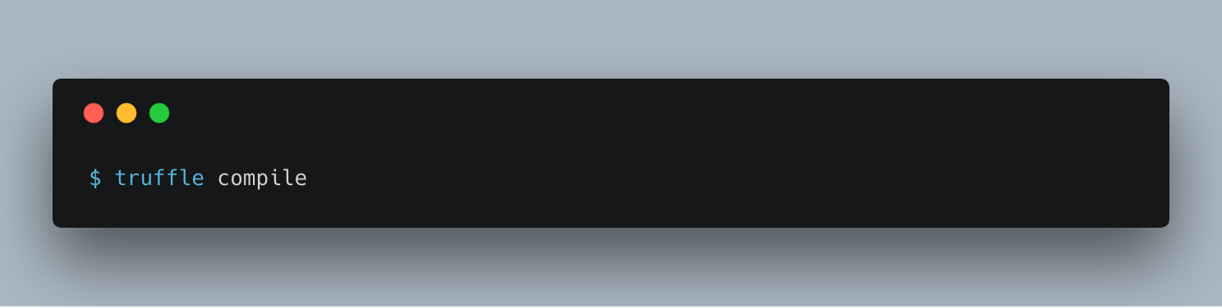
What happens when you...
2 things are created
The compiled machine code of your smart contract
The ABI (Aplication binary interface)
Think of it as a instruction manual to your compiled smart contract

Slide 7
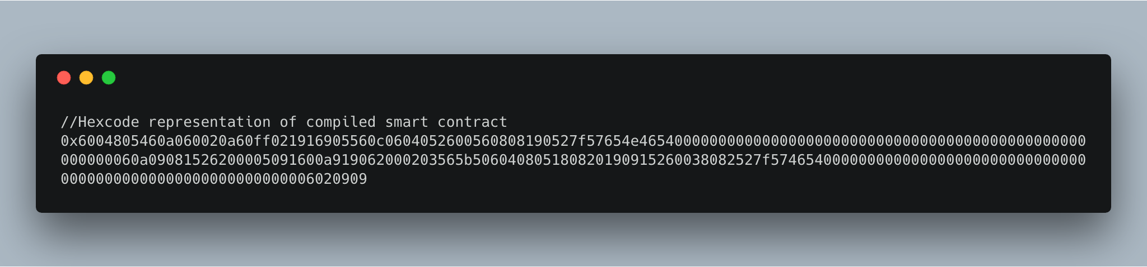
ABI and compiled code

Slide 8
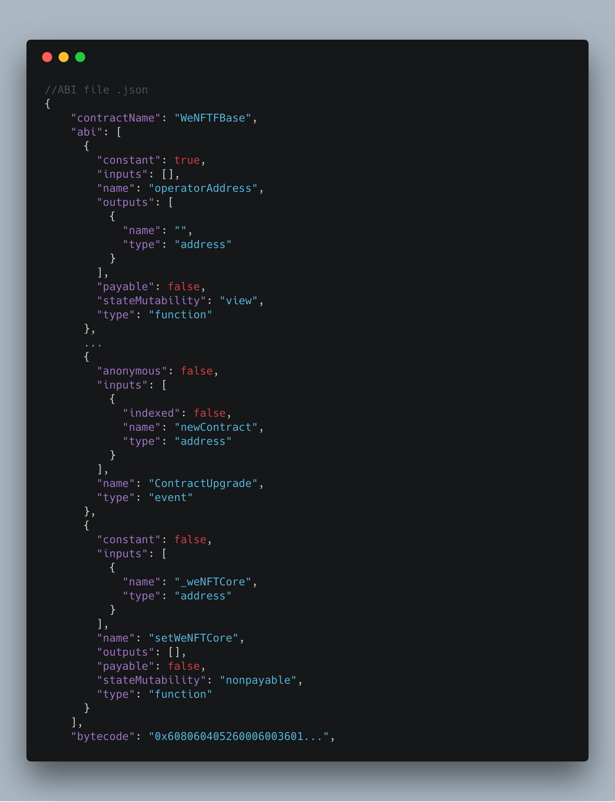
ABI and compiled code

Slide 9
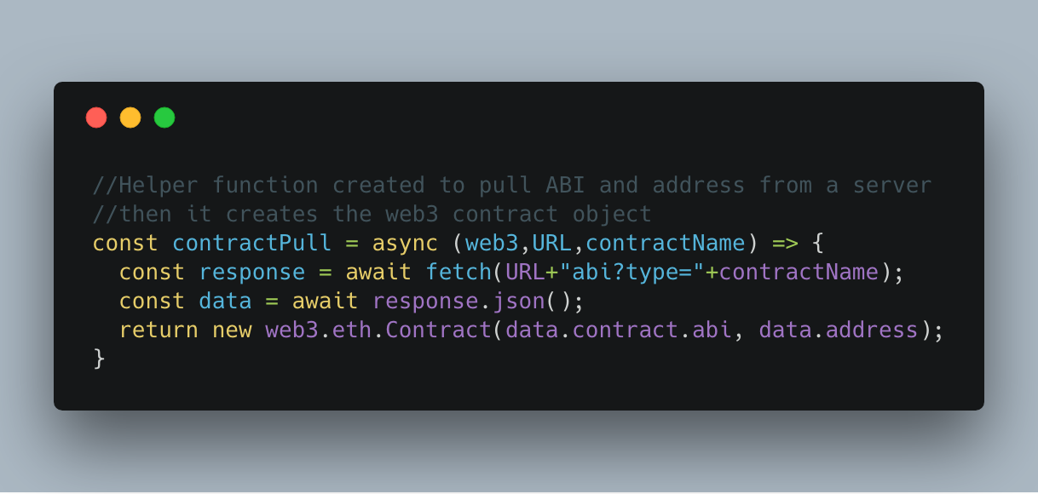
What can you do with ABI?
The ABI is how you understand how to interact with your smart contract.
In Web3.js, a contract object is constructed like so:

Slide 10
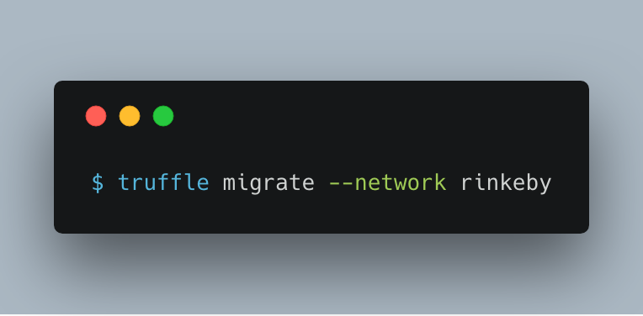
Truffle Migration
Run a elaborate script that compiles and deploys your contract to the chosen network
Allows more ‘customization’ with deploying contracts

Slide 11
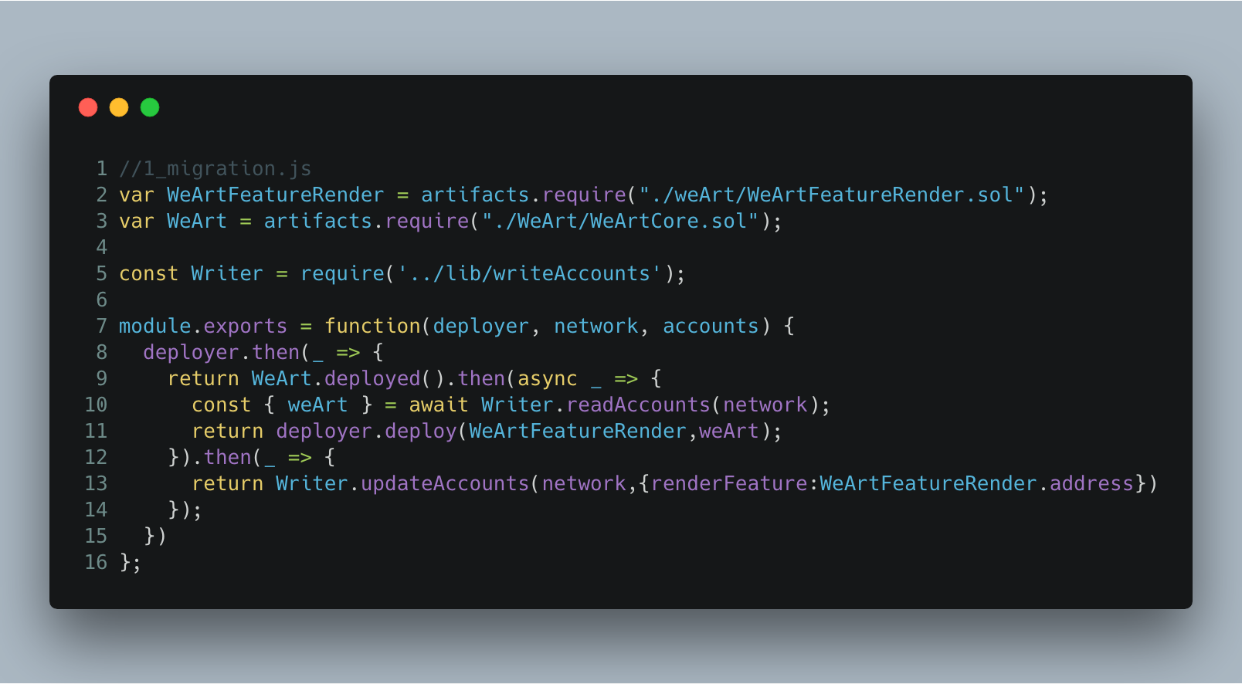
Truffle Migration
Run a elaborate script that compiles and deploys your contract to the chosen network
Allows more ‘customization’ with deploying contracts

Slide 12
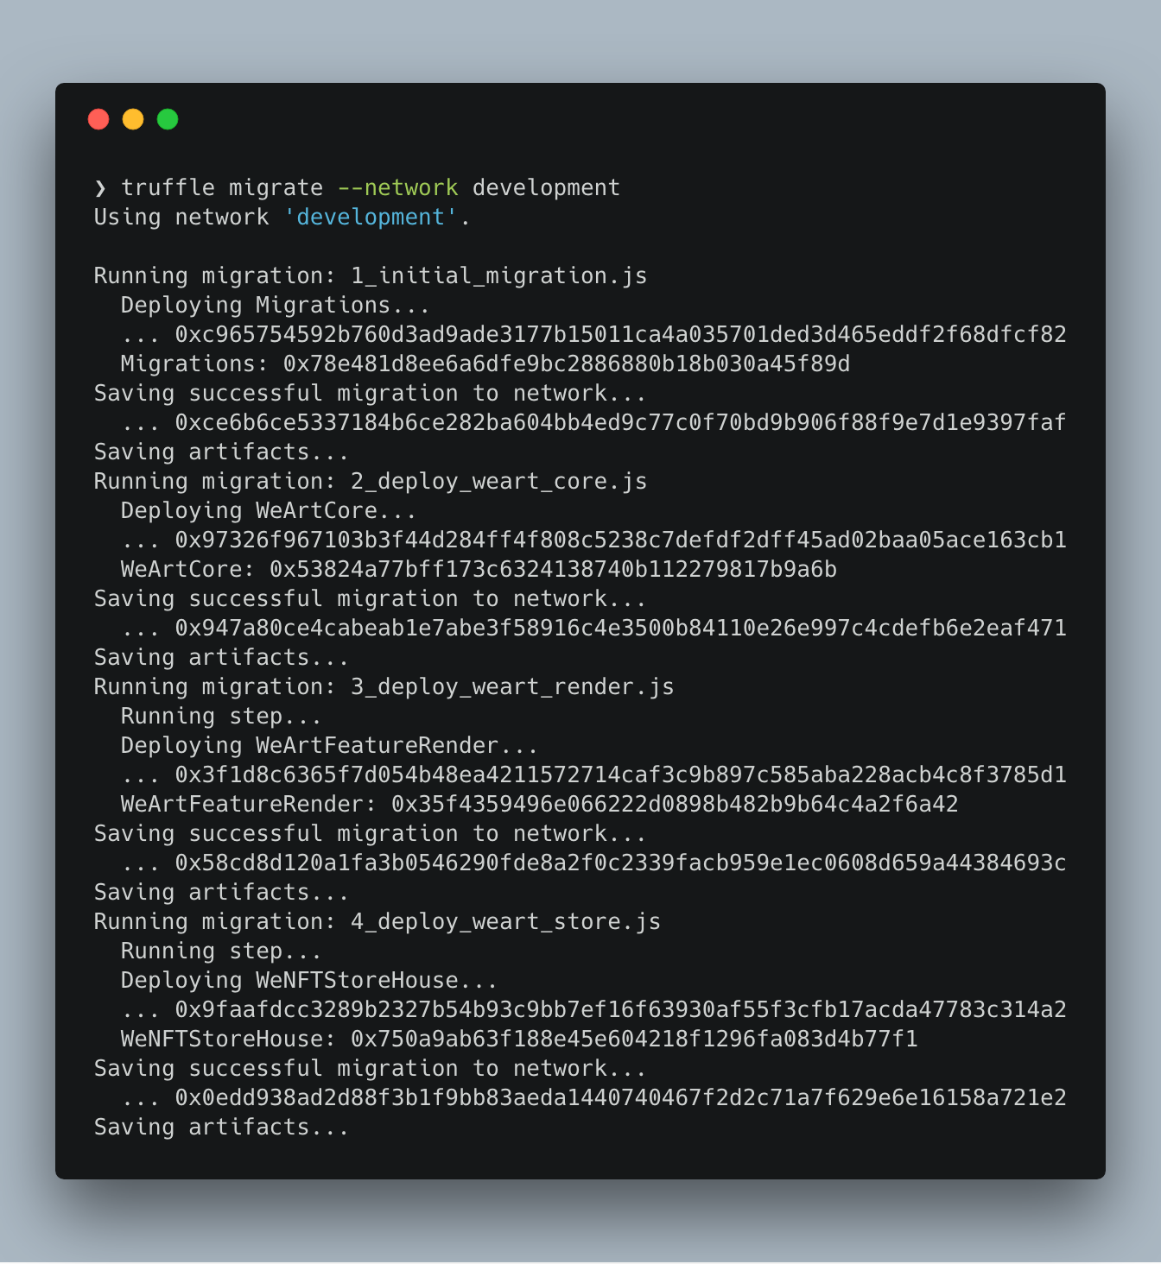
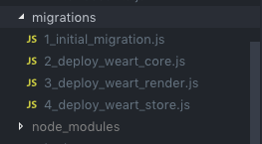
Truffle Migration
Each of these .js files are executed where contracts are deployed and any preparation processes are done.

Slide 13
Truffle Migration
Each of these .js files are executed where contracts are deployed and any preparation processes are done.

Slide 14
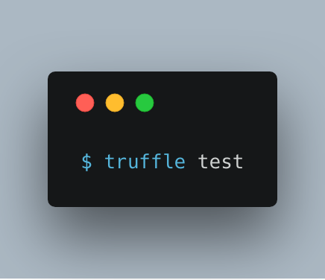
Truffle Testing
Run unit testing on your smart contracts
Your way of ASSURING that the contracts you wrote are relatively bug free
Written in JS, ran with the following command

Slide 15
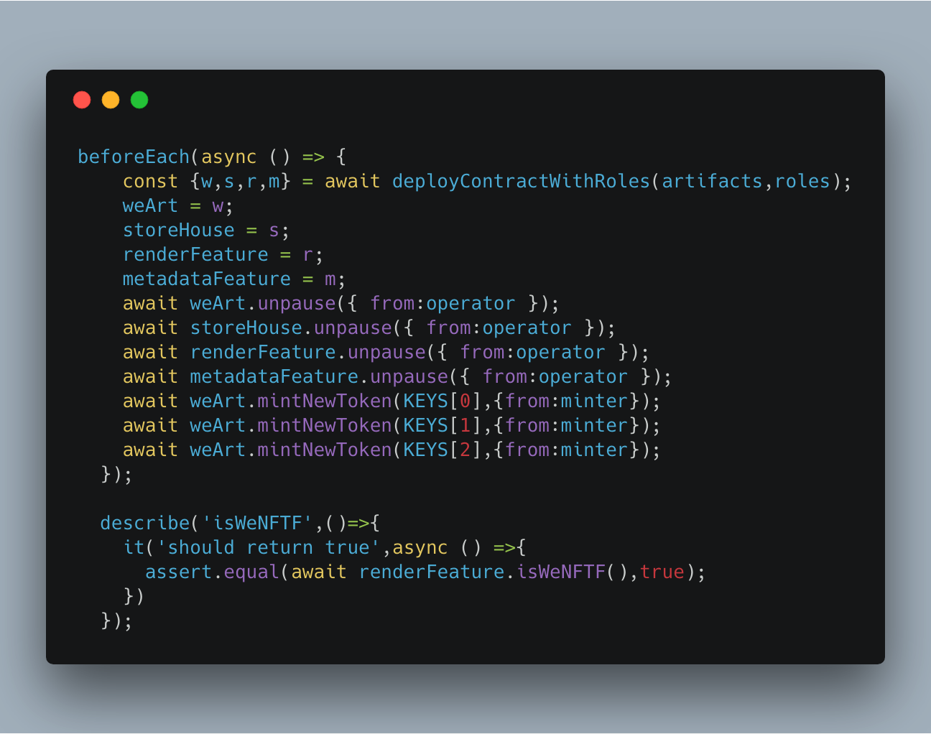
Truffle Testing

Slide 16
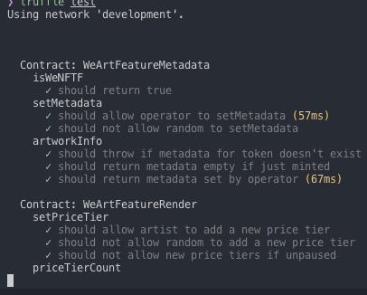
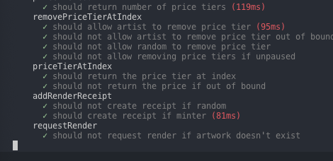
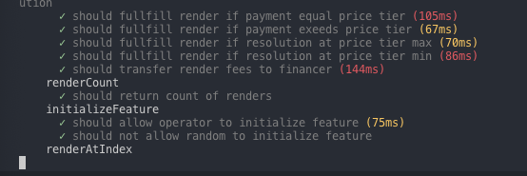
Truffle Testing

Slide 17
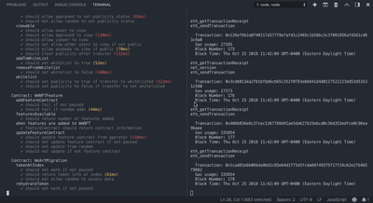
Truffle Testing

Slide 18
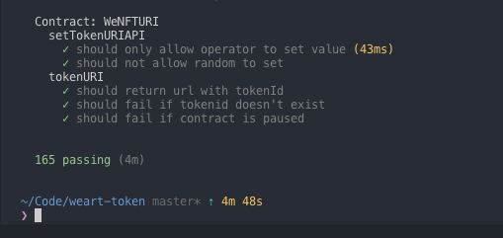
Truffle Testing

Slide 19

Ganache
Personal Blockchain for Developers
Quickly see the current status of all accounts
Addresses, private keys, transactions, and balances
Good for Unit Testing, Calculating Gas Price

Slide 20
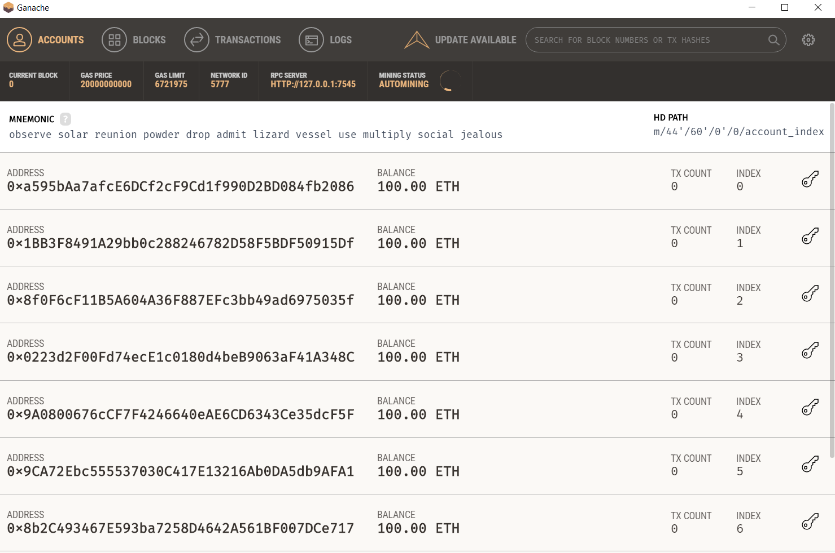

Slide 21
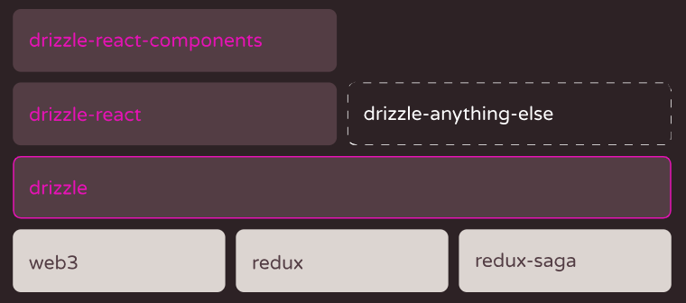
Drizzle
Front End Stuff

Slide 22
Drizzle (Cont.)
Provides a suite of utility functions to make front end dev MUCH easier
Redux reducers, actions provided
Visual library for common smart contract codes
Does require a prerequisite knowledge of React.js
Future lecture will give a crash course on React.js
Think of it as bootstrap.css/.js for writing Dapp user experiences
It’s fine if this goes over your head, we will talk about this more later.

Slide 23

Go To: https://truffleframework.com/tutorials/pet-shop

